Slide 1
MyQ Online Shopping
The technical solution design presentation

Slide 2
Overview of content
The business overview of online shopping site
The solution’s feature.
The system diagram and components
The design philosophy and microservices’ feature allocation
Data flow diagrams samples
Entity Relationship Diagrams
API Definition and Implementation

Slide 3
Business requirement overview
The MyQ shopping is an online service for goods retailers listing their products in organization of a catalogue for sale. The retailers set products’ price themself.
Customers do browsing/searching products in catalogue, comparing the price between retailers of single interested product and select. They can add the product with desired quantity to a shopping cart then checking out.
Checking out is to place an order to specific retailers of selected products.
The new order information will be notified to the retailers or called to the retailer’s online shopping API (if he/she has) for order processing & delivery
The payment method is cash on delivery due to limited startup time.
The delivery process is out of scope but only delivery status update.
The Inventory and available stock monitoring is out of scope.

Slide 4
The solution’s features highlight
Product Catalogue with Retailer’s price management
Shopping Cart
Retailer & Customer Mgt.
Order Mgt. & Delivery Tracking
Non-functional features:
Retailer Sign-up and Login
Retailer Integration for product price update, accepting order.
Third-party support of API for delivery status update.
Mobile App and Browser Support
Functional features and non-functional features

Slide 5
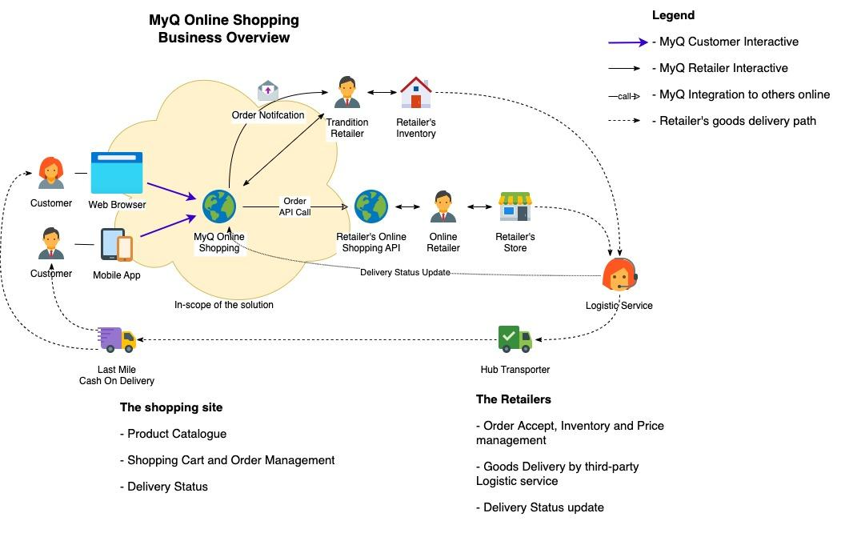
The business system illustration

Slide 6
Technical Guidance
A cloud first, clean room solution: AWS has been chosen.
Microservices and event-driven architecture.
High responsive, High scalable.
Browser and Mobile Application for client access.
Java-based technology, containerized environment prefered

Slide 7
Design philosophy
Utilize the power service of the cloud: AWS or Azure or Google Cloud
Microservice: try to separate the concern of each business feature into services.
Services could be built on any teams’ handy framework.
Setup a boundary for Microservices by their Data Model:
Aggregate object identified by public-ids for external interface.
Entities (with ids) and Value objects for internal data structure of the service.
Status (or object state) is stored as enum/flag field or existence of “linked row”.
Loose constraint of the relationship between entities. There are Application controlled external key references (not enforce the constraint).
Still using RDBMS/ORM or non-ORM for better “time-to-market” development.
Utilize JSON/XML data type of modern database for schemaless data: replacing EAV model for dynamic fields.

Slide 8
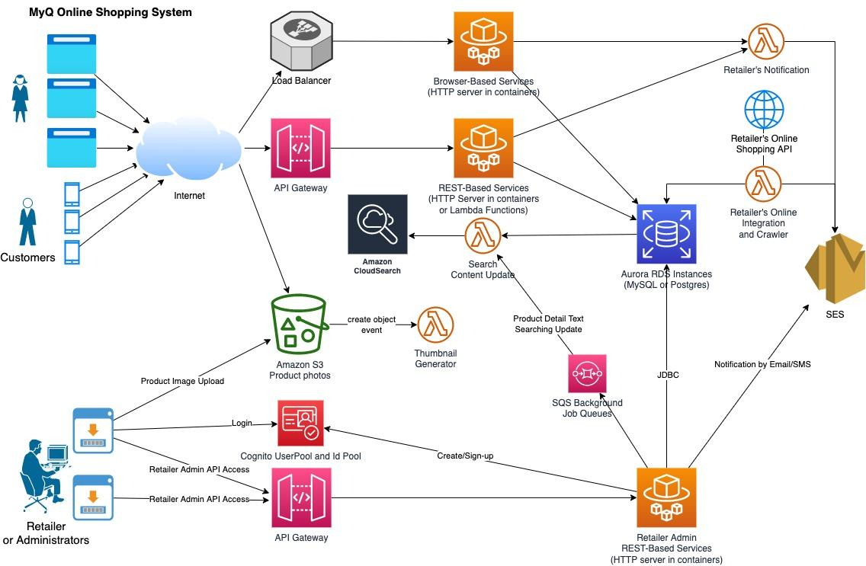
The system diagram for AWS
AWS Technology in use:
- EKS ECS Fargate for containers
- Lambda for event handlers
- SQS for job queue
- S3 for image storage and src.
- Cognito for identities provider
- API Gw, ELB, SES…

Slide 9
The choice of AWS Cloud
The biggest cloud service, very rich features.
Using container services like EKS, ECS or Fargate:
Portable kubernetes (for EKS) or containers easily to move to other cloud.
Competitive options: ECS or Fargate.
AWS S3: the good option for image storage (million++ images)
AWS SQS: suitable for job queues, asynchronous, fast and realiable.
AWS Lambda: using for handler or they can be invoked directly.
AWS Cloud Search: cheaper than Elastic Search.
The most familiar cloud service for the author.

Slide 10
The choice of software platforms
Choosing software platform to build Microservices (REST API or Web): Spring Boot, Spring MVC/DAO, Java EE Jax-RS, Java Servlet, or Quarkus, Micronaut… whatever best for the team, one service can differs others.
AWS Java SDK v2, or any supported AWS language.
Lambda: Java core (faster cold-start) or NodeJS, Python.
Integration with Spring-integration (easy) or Java Core (faster).
Front-end: VueJS, Angular, ReactJS… but first landing should be static page.
AWS Cognito: OAuth2 for both Retailer and Customer sign-up/login and account activation.

Slide 11
Microservices’ Designing
based-on business requirement

Slide 12
Microservices scoping
The system should be divided into following components:
Product catalogue and price management
Shopping cart: quotation and customer onboarding and check out process
Order management and delivery tracking
Retailer sign-up and admin UI
Each component covers one step of e-commerce sale pipeline: browsing products, product selection and quotation, make order, delivery and support.
The service can directly served client request without a “composited service” in front. There are session/tokens for authentication and authorization.
Events of a service will be processed by functions of the service by sharing job queues, or system events, or asynchronouse invoking.

Slide 13
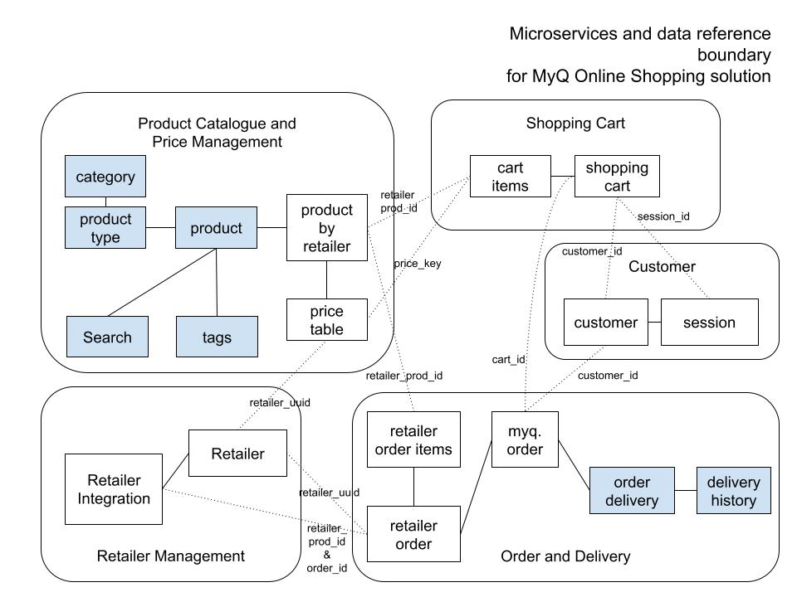
Microservice entity boundary
Business Entities Scope:
- Product with price table, products by retailters
- Shopping cart
- Order and Delivery
- Customer and session
- Retailers

Slide 14
Product catelogue
Features and solution:
Product Organization
Product Browsing
Product Searching
Retailer product price offering
Solutions for scalable:
Caching web pages/responses.
Read-only database clusters.
Service for first landing shopping

Slide 15
Product Catalogue service features
Organizing the products in 2 kinds of classifying (example in the next slide):
Hierarchy: Root is category, Leaves are product types. Multi-level of product types allowed.
Tags: combination of attributes for each product. Attribute meaning is existent of a tag.
The product stores dynamic fields to display product’s data sheet to the customer (inc. product photo src.). The product may have variants but sharing same detail & price.
Search by keywords: dynamic fields’ contents are indexed for keywords search.
Each product may be offered by retailers along with their price. It may be listed or unlisted for sale to the customer browsing by their self (multi-tenant of retailers).
Retailers with their own online shopping will be supported to “synchronize offered price” from their online shopping by API (if applicable).
The offered price once selected by customer, it should be a snapshot version at the selection time and not affected by price modification later.
Product Catalogue operation is heavily reading, occasionally writing.

Slide 16
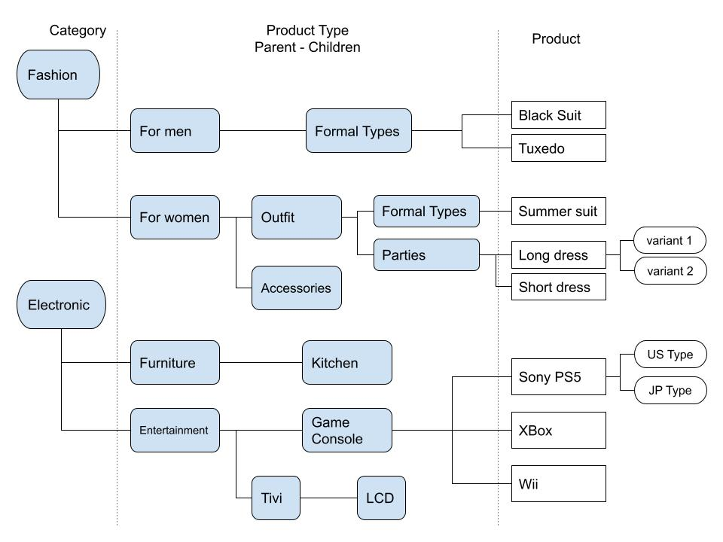
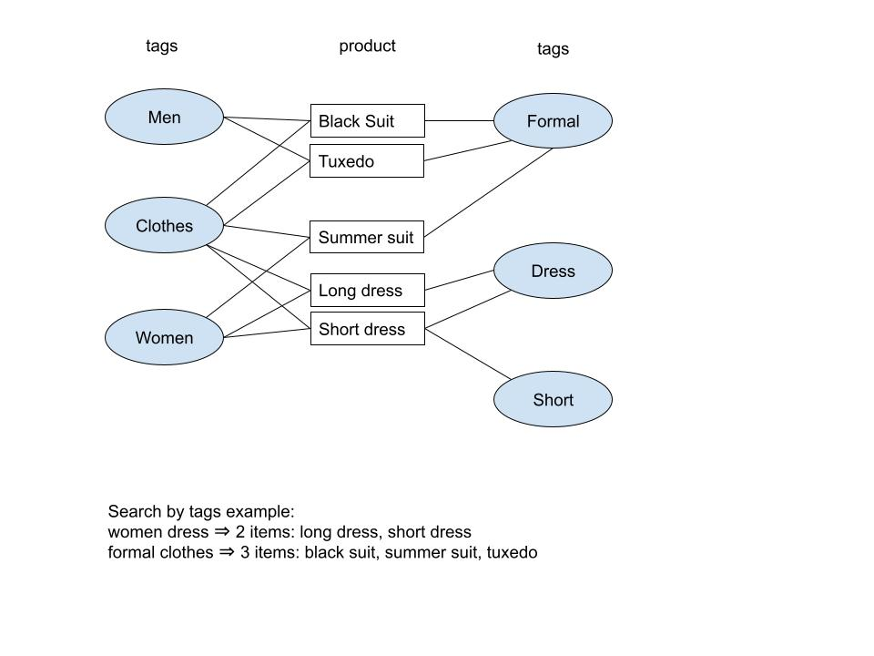
Product category/type hierarchy sample (hierarchy organization)
Product tags sample

Slide 17
How the tag_names should be built
Tag names built by concatenate/join of sorted names for indexing friendly.
The ordered tags’ name set of a product will be combine as the “Carterian product” of possible combinations.
The existent of the names means the product has corresponding tags.
For example, the product with 3 tags: “men” “formal” “clothes” will be:
Sorting by alphabet of names: clothes formal men
All possible combinations: “clothes-formal-men”, “clothes-formal”, “clothes-men”, “clothes”, “formal-men”, “formal”, “men”
Searching by tags is equally comparing tag_names == “searching-tags”.
The tags table could be huge, it is best to utilize distributed “hash” index.

Slide 18
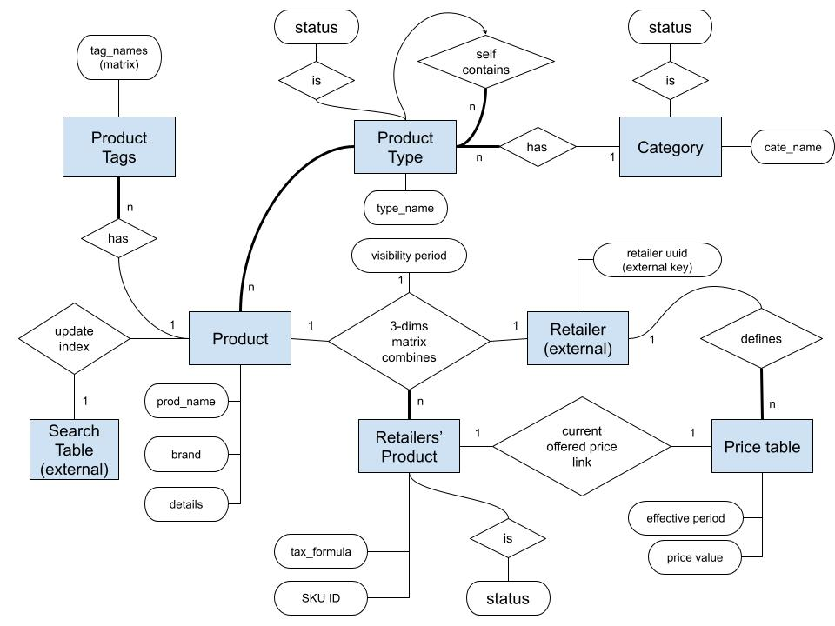
Category, Product & Types with price table ERD
Entities:
- Category
- Product type
- Product with Product Tags
- Retailer Product
- Price table
- Keywords Search Index (external)

Slide 19
Product Catalogue implementation guidance
Most of operations are simple CRUD versus the product database.
Two special operations:
Tag names generation and search for product tagging. Tags will be selection from a list of available tags on each tag group.
Price synchronization for retailers who has their own online shopping website (that supports API too).
Keywords searching: using API from Cloud Search. Cloud Search index will be updated each time the product detail updated.
JSON (or XML) collumn data to extract/show/manipulation by functions natively provide by RDBMS (eg. MySQL, PostgreSQL).
Retailer_uuid is for authorization/identify which retailer can access “product by retailers” and “price table”.

Slide 20
Price Data synchronization guidance
An unique feature to support retailers who have their own online-shopping. (assuming they’re maintaining a “master copy” of price data there).
A sync. process to update the prices by mapping from the online-shopping API. API URL set by the retailers and API must comply with MyQ’s definition.
Event to kick start the synchronize process would be:
From manually.
On-demand by customer when checking out or any action that needs the latest/fresh price.
From reaching to expire time (in batch updating).
From reaching to caching time + lifetime each view product price action.
The process is handle by SQS event-queues for single or batch updating.

Slide 21
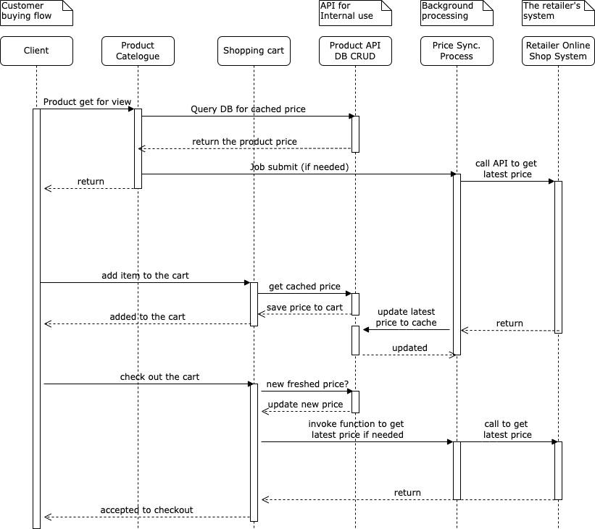
Price selection from retailer online shop
- The product offered by retailer from their online shopping.
- Client clicks to view product in detail
- Product Catelogue query its DB for cached price, and cached lifetime whether it’s be refresh → a new job.
- Later phases: add item to cart or checkout ⇒ the process needs “a latest version of price value” before checking out.

Slide 22
Product Catalogue sub-components
Load Balancer
Web Servers
(static and pre-render content)
AWS Cloud Search
Browser
Single Page App
Product DB
API Gateway
REST API Servers
Mobile App
Cognito Login OAuth2
token verifying for retailers
Price sync., tags gen… process
SQS
AWS S3
Thumbnail generator

Slide 23
Product Catelogue scalable options
Load Balancer with cache
(web page or API response)
AdminWeb Server
Web Server
Web Server
Web Server
Web Server
Web Server
RW
DB
RO
DB
RO
DB
RO
DB
Option 1:
Caching at the edge with load balancing
Option 2:
Database Replication with read-only databases
RW DB

Slide 24
Shopping cart features
Features
Maintaining a cart of items
Price quotation view
Buying continueing on other device same customer
Anonymous customer cart.
Solution for scalable:
Sharding in Web or DB layer
In-memory database
Service for the customer select products to buy

Slide 25
Shopping cart service features
Create a cart for each session of customer (anonymous or logged-in)
Allowing customer add items to cart.
The cart could be access from multiple device for logged-in customer.
Each item is specified:
Product ID from specific retailer
Price value at choice.
Quantity of the product.
Variant of the product (if any)
The cart may be saved and restore for buying later (optional feature)
The cart is temporally in lifetime, its’ operation is reading/writing balance.

Slide 26
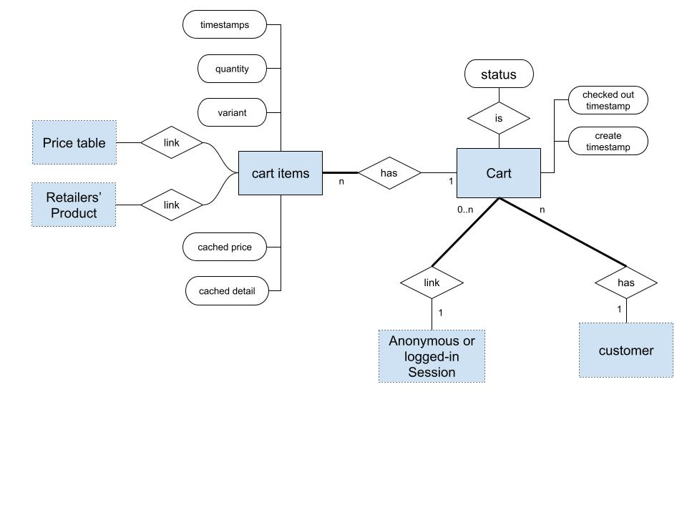
Shopping Cart ERD
Entities:
- Cart
- Cart items
Linked to:
- Customer and Session
- Retailer Product
- Price table
More please look at “Shopping Cart Table Design” illustration.

Slide 27
Shopping cart implementation guidance
Most of operations are simple CRUD.
A cart could be created on first “adding to cart” of a item, with:
session_id: set to bind/create_by for identifying which session create the cart (both anonymous customer and logged-in customer).
customer_id: set when session_id has binded to the logged-in customer.
The cart can hand-over between same customer_id on multiple devices.
The cart items collection following data:
retailer_prod_id and price key from the Product Catalogue Services.
Get price from price table then caching it.
Get detail from product detail then caching it for faster display product detail (without join or get from Product Catalogue Service.
Latest price verification: on checking out, the price may be re-verify from Product Catelogue Service and get from retailer online shop and warning if any change.
The cart_id of“checking out” cart has to be sent to the Order service to create new order.

Slide 28
Shopping Cart Scalable options
API path must contains the cart_id - except creating new
Load Balancer with routing by path
hash of cart_id based routing or randomly if no cart_id
Option:
Sharding by cart_id
Web Servers
Web Servers
Web Servers
Web Servers
Option:
Using in-memory database
RW DB
RW DB
RW DB
RW DB
databases workload should be reading/writing balance and partitioning

Slide 29
Order and Delivery Service
Order management
Integration with retailers’ online service for order placing.
Delivery status tracking and update
Store and tracking orders and their history

Slide 30
Order and Delivery features
Create a new order, its item linked with the customer (if new) from the cart. The new order has:
Main order (in customer view)
Retailer orders for each retailer of items that the customer selected.
Item for reach retailer order with: variant, quantity, sell price and tax.
Single delivery address and contact for the order and its tracking history. The delivery address can be changed by add a new delivery and new tracking history.
Notify the retailers for the new retailer-order (if not own online shop) or the integration function to place retailer order to their site.
Delivery tracking adding to the delivery status in general (for customer) or status for each retailer.

Slide 31
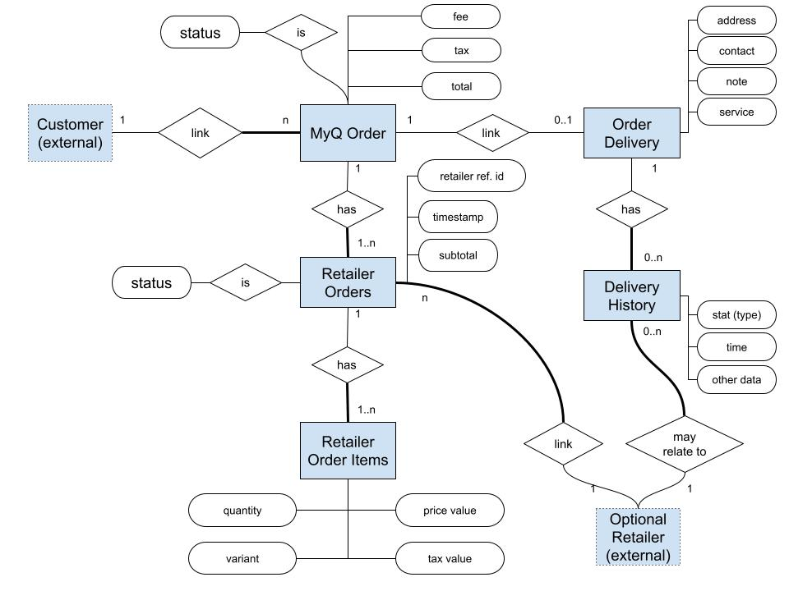
Order & Delivery ERD
Entities:
- MyQ Order (main order storage)
- Retailer Order
- Retailer Order items.
- Order Delivery: address, contact…
- Order Delivery History.

Slide 32
Retailer Service
Retailer management
Retailer Integration Information

Slide 33
Retailer Service features
Creating retailer via AWS Cognito signing-up.
Login by Cognito using OAuth2 for authorization by retailer_uuid.
The retailer set their option: with or without own online shopping service
The retailer set up API for integration: URL, authentication (server to server), and API definition/protocol supported by MyQ Shopping.

Slide 34
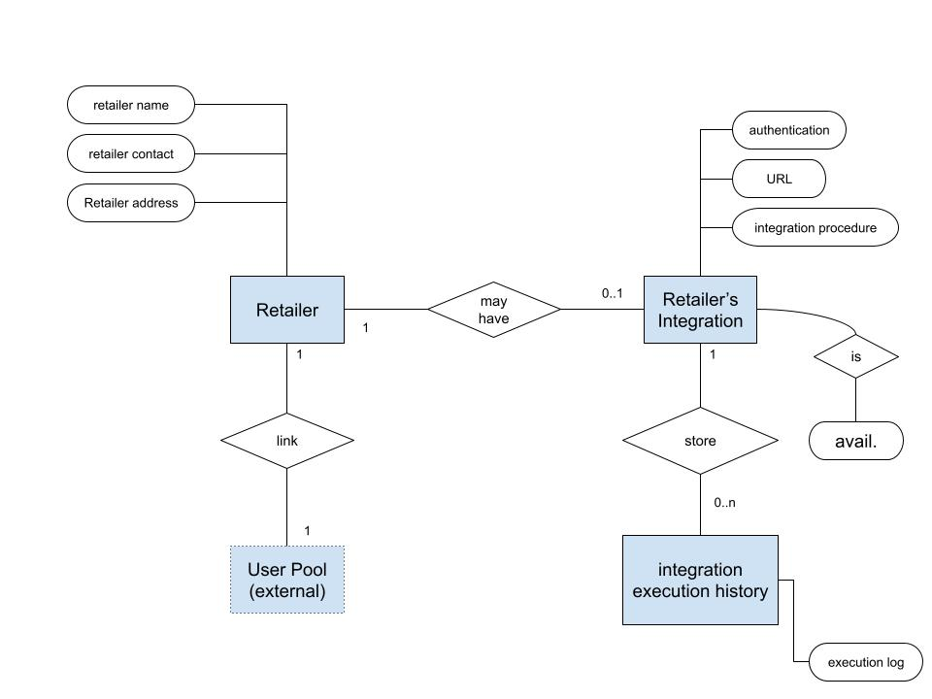
Retailer ERD
Entities:
- Retailer (primary key by retailer_uuid)
- Retailer Integration and execution history (for debug log).
- Login/Activation by Cognito (external database)

Slide 35
Customer and Session Service
Simple Customer Management
Session Management

Slide 36
Customer and Session Service features
Maintain client sessions for anonymous browsing and shopping.
Anonymous session turns into identified-session when checking out. to create a new customer for the order.
Customers can sign-up their account via Cognito Sign-up (support both Mobile App. and Browser-based)
Cognito is used for authenticate a customer as the logged-in customer.
Logged-in Customers can have multiple sessions for cross-device shopping.

Slide 37
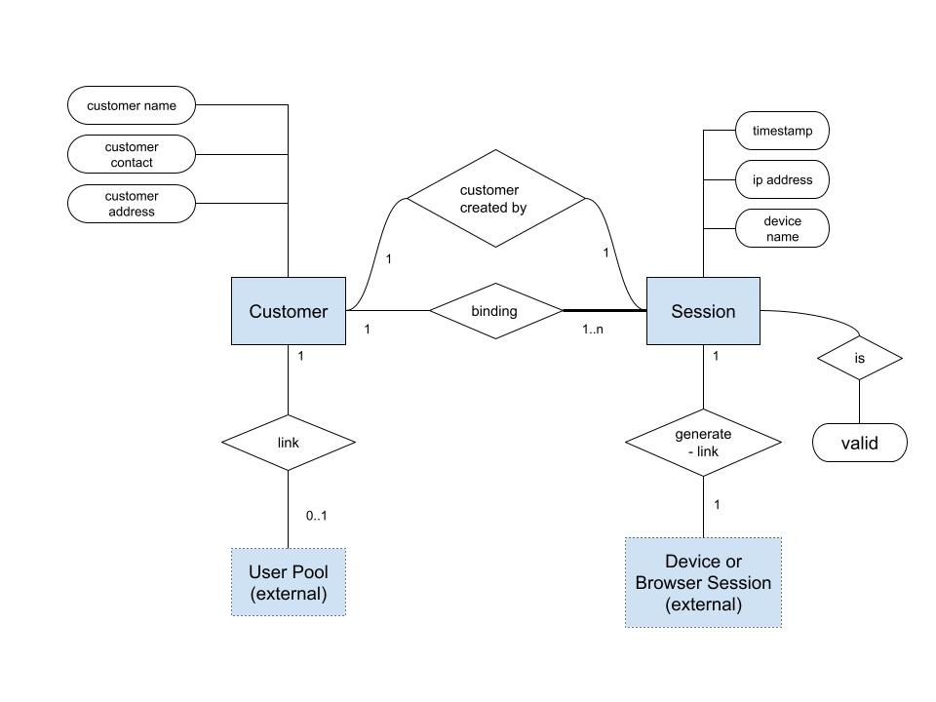
Customer and Session ERD
Entities:
- Customer: basic attributes.
- Session: hold the session id and information for browsing.
- Device storage or session storage: hold the session_id as a Session entity.
- Cognito User Pool: keep activation and login username password.

Slide 38
End
The MyQ Online Shopping needs improvement of Inventory for the ful-feature of ecommerce system.

